Slide 1
Statistical methods in information theory gene network reconstruction | epigenetic causal discovery
Soumik Purkayastha
Department of Biostatistics, University of Michigan
2023-12-15

Slide 2
Statistical methods in information theory gene network reconstruction | epigenetic causal discovery
Soumik Purkayastha
Department of Biostatistics, University of Michigan
2023-12-15

Slide 3
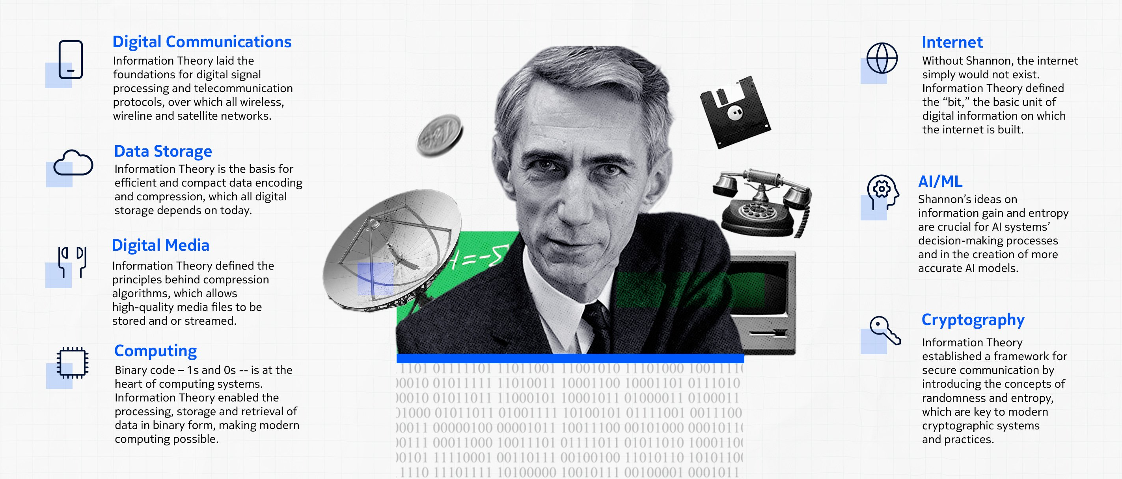
Why information theory?
Branch of applied mathematics and electrical engineering that involves quantifying information (Shannon (1948)).
Original scope was to quantify namely data compression and error correction over a noisy channel.
“Information Theory Turns 75.” Nokia Bell Labs, www.bell-labs.com/about/history/innovation-stories/information-theory-turns-75/. Accessed 12 Dec. 2023.
Notes:
75 years ago, a paper titled “A Mathematical Theory of Communications” appeared in the Bell System Technical Journal.
The world would never be the same. In that paper, Bell Labs researcher Claude Shannon laid out the principles that govern all communications.
He also first described the “bit” – the most fundamental unit of digital information.
Today, ideas on information gain and entropy are crucial for machine learning tools.

Slide 4
Why information theory?
Branch of applied mathematics and electrical engineering that involves quantifying information (Shannon (1948)).
Original scope was to quantify namely data compression and error correction over a noisy channel.
“Information Theory Turns 75.” Nokia Bell Labs, www.bell-labs.com/about/history/innovation-stories/information-theory-turns-75/. Accessed 12 Dec. 2023.
Notes:
75 years ago, a paper titled “A Mathematical Theory of Communications” appeared in the Bell System Technical Journal.
The world would never be the same. In that paper, Bell Labs researcher Claude Shannon laid out the principles that govern all communications.
He also first described the “bit” – the most fundamental unit of digital information.
Today, ideas on information gain and entropy are crucial for machine learning tools.

Slide 5
Why information theory?
Branch of applied mathematics and electrical engineering that involves quantifying information (Shannon (1948)).
Original scope was to quantify namely data compression and error correction over a noisy channel.
Brand loyalty: Shannon was born in Michigan and went to UM before moving to MIT.
“Information Theory Turns 75.” Nokia Bell Labs, www.bell-labs.com/about/history/innovation-stories/information-theory-turns-75/. Accessed 12 Dec. 2023.
Notes:
75 years ago, a paper titled “A Mathematical Theory of Communications” appeared in the Bell System Technical Journal.
The world would never be the same. In that paper, Bell Labs researcher Claude Shannon laid out the principles that govern all communications.
He also first described the “bit” – the most fundamental unit of digital information.
Today, ideas on information gain and entropy are crucial for machine learning tools.

Slide 6
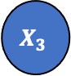
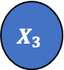
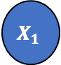



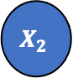
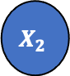
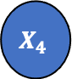
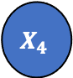
Overview: two statistical questions
$$X_{3}$$
$$X_{3}$$
$$X_{1}$$
$$X_{2}$$
$$X_{5}$$
$$X_{1}$$
$$X_{2}$$
$$X_{5}$$
$$X_{4}$$
$$X_{4}$$
(a) Association in a set of variables
(b) Directionality in a set of variables

Slide 7
Overview: two statistical questions
$$X_{3}$$
$$X_{3}$$
$$X_{1}$$
$$X_{2}$$
$$X_{5}$$
$$X_{1}$$
$$X_{2}$$
$$X_{5}$$
$$X_{4}$$
$$X_{4}$$
(a) Association in a set of variables
Information: how much is shared?
(b) Directionality in a set of variables
Information: direction of flow?

Slide 8
Statistics and information theory
$$X_{3}$$
$$X_{3}$$
$$X_{1}$$
$$X_{2}$$
$$X_{5}$$
$$X_{1}$$
$$X_{2}$$
$$X_{5}$$
$$X_{4}$$
$$X_{4}$$
In this talk: embed notions of association and directionality in information theoretic framework.
Deliverables:
Measure association in gene networks
Detect directionality between DNA methylation and blood pressure

Slide 9
Statistics and information theory
$$X_{3}$$
$$X_{1}$$
$$X_{2}$$
$$X_{5}$$
$$X_{4}$$
In this talk: embed notions of association and directionality in information theoretic framework.
Deliverables:
Measure association in gene networks
Detect directionality between DNA methylation and blood pressure

Slide 10
Quantifying complex association using mutual information <gene network reconstruction>
Purkayastha, Soumik, and Peter X.-K. Song. “fastMI: A Fast and Consistent Copula-Based Nonparametric Estimator of Mutual Information.” Journal of Multivariate Analysis, November 2023, 105270.

Slide 11
Overview
Gene expression data is an artifact of an underlying gene network.
Using gene expression data, wish to estimate latent gene network.
Association in gene expression data informs underlying network.
Aim: Using information theory, infer underlying network in a fast and accurate manner.
Example: DREAM3 yeast gene expression data (network size = 10).

Slide 12
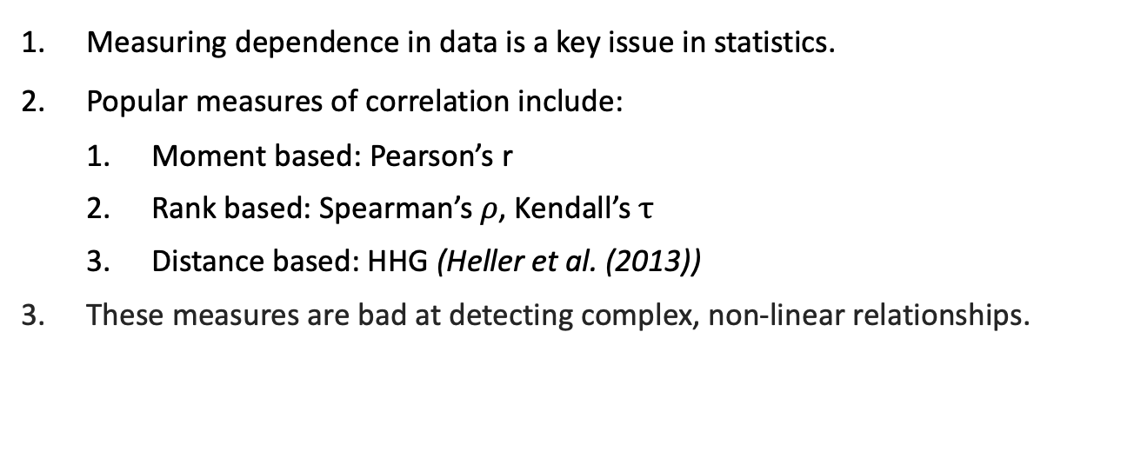
Association studies
Measuring dependence in data is a key issue in statistics.
Popular measures of correlation include:
Moment based: Pearson’s r
Rank based: Spearman’s $ρ$, Kendall’s $τ$
Distance based: HHG (Heller et al. (2013))
These measures are bad at detecting complex, non-linear relationships.
Heller, Ruth, Yair Heller, and Malka Gorfine. "A consistent multivariate test of association based on ranks of distances." Biometrika 100.2 (2013): 503-510.

Slide 13
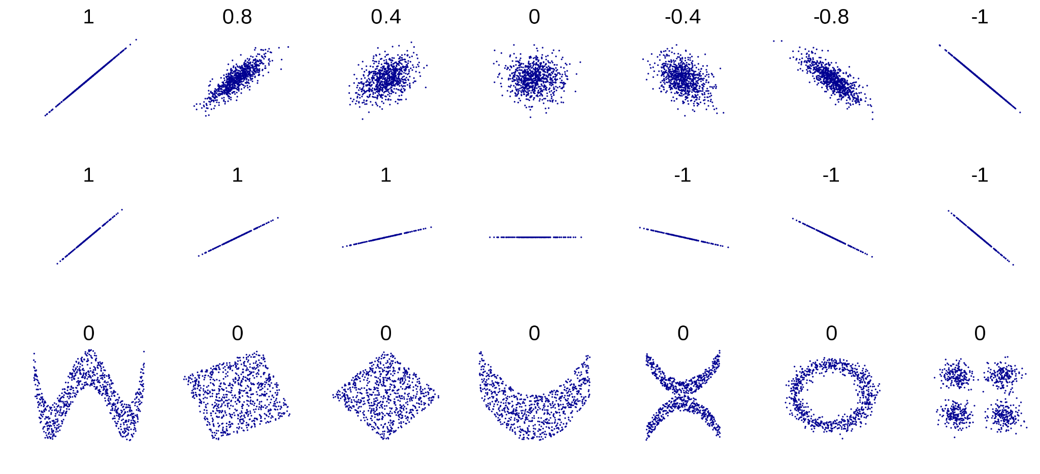
Complex dependence
Contsaent
Here are some typical examples of scatterplots for bivariate data ⬆️
But more complex patterns CAN exist!! ⬇️

Slide 14
Complex dependence
Contsaent
Pearson, Spearman, Kendall, and HHG:
“These are ‘good’ data to capture association ⬆️”
Pathological examples:
“These are ‘bad’ data to capture association ⬇️”

Slide 15
Complex dependence
Contsaent
Pearson, Spearman, Kendall, and HHG: moment-based, rank-based, and distance-based.
Claude E. Shannon: focused on the densities of random variables to propose Mutual Information (MI).
Using information theory, MI can detect association in ALL these cases.

Slide 16
Association in information theory
Information theory = probability + statistics + engineering.
Theoretical framework for quantifying association in statistical models.
Mutual information is a powerful measure of association!

Slide 17
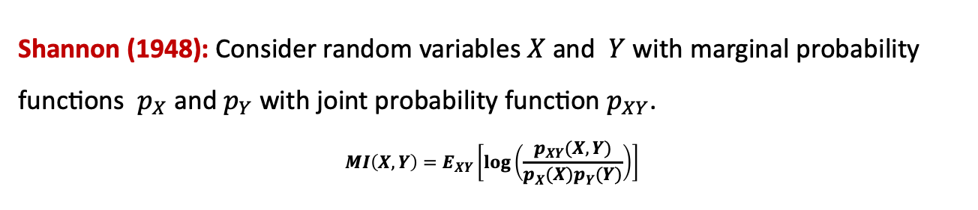
Association in information theory
Information theory = probability + statistics + engineering.
Theoretical framework for quantifying information in statistical models.
Mutual information is a powerful measure of association!
Shannon (1948): Consider random variables $X$ and $Y$ with marginal probability functions $p_{X}$ and $p_{Y}$ with joint probability function $p_{XY}$.
$$MI\left(X, Y\right)=E_{XY}\left[log\left(\frac{p_{XY}(X, Y)}{p_{X}(X)p_{Y}(Y)}\right)\right]$$
Shannon, C. E. “A Mathematical Theory of Communication.” Bell System Technical Journal 27, no. 3 (1948): 379–423. https://doi.org/10.1002/j.1538-7305.1948.tb01338.x.

Slide 18
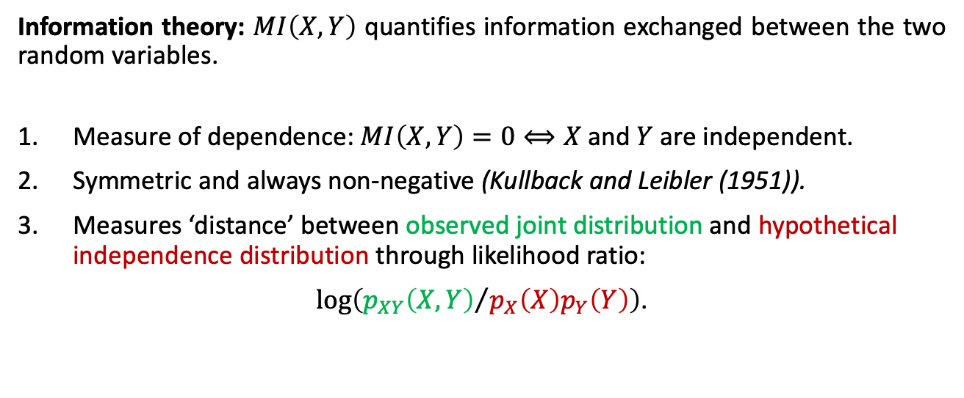
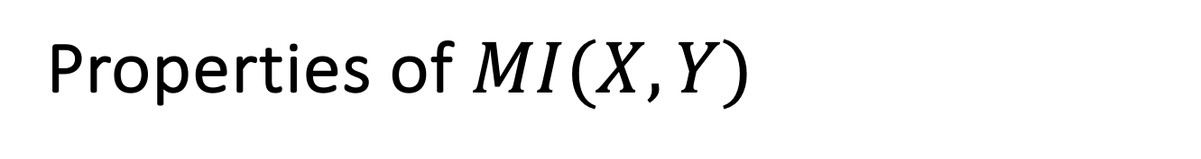

Properties of $MI(X, Y)$
$$MI\left(X, Y\right)=E_{XY}\left[log\left(\frac{p_{XY}(X, Y)}{p_{X}(X)p_{Y}(Y)}\right)\right]$$
Information theory: $MI\left(X, Y\right)$ quantifies information exchanged between the two random variables.
Measure of dependence: $MI\left(X, Y\right)=0⟺X$and $Y$ are independent.
Symmetric and always non-negative (Kullback and Leibler (1951)).
Measures ‘distance’ between observed joint distribution and hypothetical independence distribution through likelihood ratio:
$log\left({p_{XY}\left(X, Y\right)}/{p_{X}\left(X\right)p_{Y}\left(Y\right)}\right)$.
Kullback, Solomon, and Richard A. Leibler. "On information and sufficiency." The annals of mathematical statistics 22.1 (1951): 79-86.

Slide 19
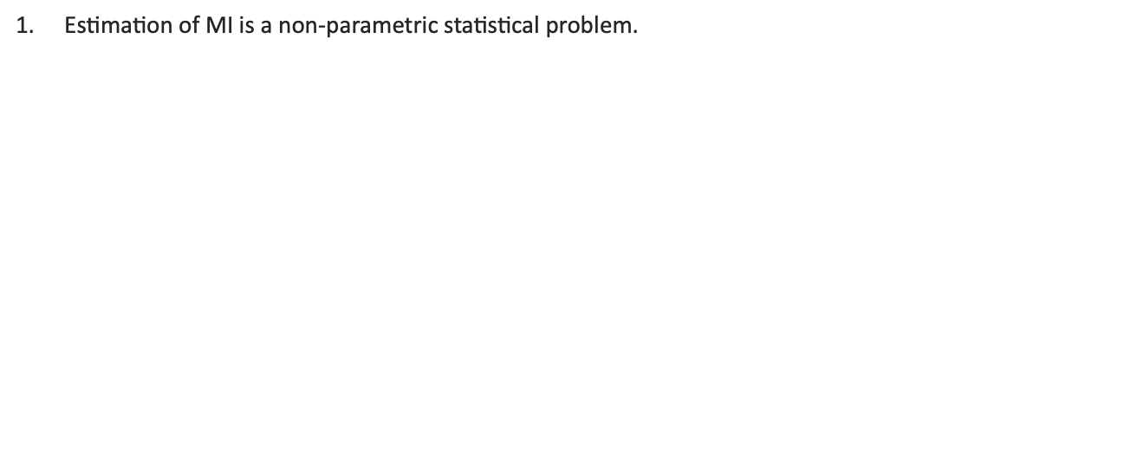
Challenge: estimation and inference
Estimation of MI is a non-parametric statistical problem.
Typical challenges involve:
Estimation without incurring predetermined tuning parameters.
Theoretical guarantees on performance: consistency and asymptotic normality.
Establishing an $MI$-based rule to test for independence.
$MI$ estimation techniques
𝑀𝐼 estimation techniques
Kernel density estimation (KDE)
(Zeng et al. (2018))
k-nearest neighbour (k-NN)
(Kraskov et al. (2004))
Parameter tuning
Bandwidth tuning
Time-consuming
Weak theoretical guarantees
1. Zeng, Xianli, Yingcun Xia, and Howell Tong. "Jackknife approach to the estimation of mutual information." Proceedings of the National Academy of Sciences 115.40 (2018): 9956-9961
2. Kraskov, Alexander, Harald Stögbauer, and Peter Grassberger. "Estimating mutual information." Physical review E 69.6 (2004): 066138.

Slide 20
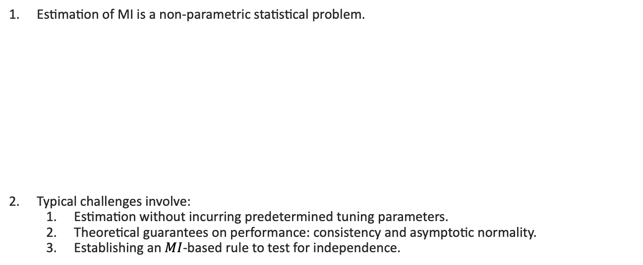
Challenge: estimation and inference
Estimation of MI is a non-parametric statistical problem.
Typical challenges involve:
Estimation without incurring predetermined tuning parameters.
Theoretical guarantees on performance: consistency and asymptotic normality.
Establishing an $MI$-based rule to test for independence.
$MI$ estimation techniques
𝑀𝐼 estimation techniques
Kernel density estimation (KDE)
(Zeng et al. (2018))
k-nearest neighbour (k-NN)
(Kraskov et al. (2004))
Parameter tuning
Bandwidth tuning
Time-consuming
Weak theoretical guarantees
1. Zeng, Xianli, Yingcun Xia, and Howell Tong. "Jackknife approach to the estimation of mutual information." Proceedings of the National Academy of Sciences 115.40 (2018): 9956-9961
2. Kraskov, Alexander, Harald Stögbauer, and Peter Grassberger. "Estimating mutual information." Physical review E 69.6 (2004): 066138.

Slide 21
New work: fastMI
$MI$ estimation techniques
𝑀𝐼 estimation techniques
Kernel density estimation (KDE)
(Zeng et al. (2018))
k-nearest neighbour (k-NN)
(Kraskov et al. (2004))
fastMI
(Purkayastha and Song (2023a))
Fast Fourier transform-based estimation: no tuning required!
Consistent estimator!
Improved accuracy.
Better statistical power when testing for association.
R package available!
Purkayastha, Soumik, and Peter X.-K. Song. “fastMI: A Fast and Consistent Copula-Based Nonparametric Estimator of Mutual Information.” Journal of Multivariate Analysis, November 2023, 105270.

Slide 22
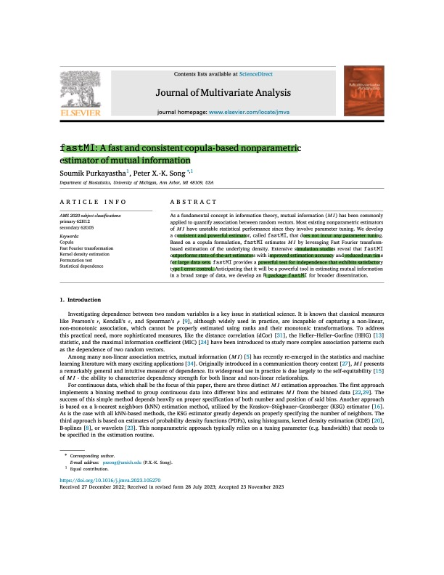
fastMI beats current standard!
Copula-based: robust to outliers in data.
Leverage tuning-free density estimation through Fourier transformation.
Simulations: improved accuracy and reduced run-time.
fastMI beats standard estimators in empirical power comparisons.

Slide 23
Application I
fastMI-based gene network reconstruction using gene expression data

Slide 24
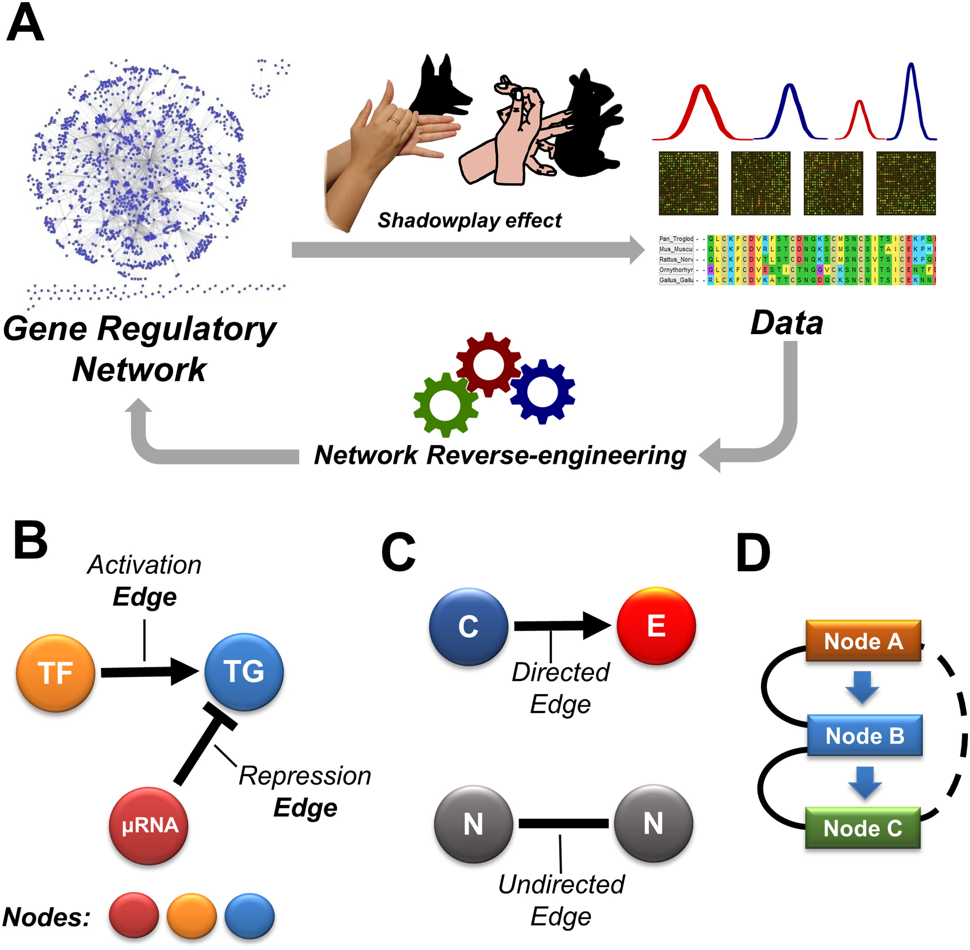
Scientific background
Transcriptional regulation is a fundamental molecular mechanism described by Gene Regulatory Networks (GRNs).
Latent: GRN controls transcriptional regulation.
Observable: “projection” of GRN that generates gene expression data.
Problem: Reverse engineer observable data to infer latent structure.
Mercatelli, Daniele, et al. "Gene regulatory network inference resources: A practical overview." Biochimica et Biophysica Acta (BBA)-Gene Regulatory Mechanisms 1863.6 (2020): 194430.

Slide 25
Scientific background
Transcriptional regulation is a fundamental molecular mechanism described by Gene Regulatory Networks (GRNs).
Latent: GRN controls transcriptional regulation.
Observable: “projection” of GRN that generates gene expression data.
Problem: Reverse engineer observable data to infer latent structure.
Mercatelli, Daniele, et al. "Gene regulatory network inference resources: A practical overview." Biochimica et Biophysica Acta (BBA)-Gene Regulatory Mechanisms 1863.6 (2020): 194430.
Notes:
Latent: GRN controls transcriptional regulation in living cells.
Observable: “projection” of GRN that generates gene expression data from qualitative and quantitative empirical measurements

Slide 26
Scientific background
Transcriptional regulation is a fundamental molecular mechanism described by Gene Regulatory Networks (GRNs).
Latent: GRN controls transcriptional regulation.
Observable: “projection” of GRN that generates gene expression data.
Problem: Reverse engineer observable data to infer latent structure.
Mercatelli, Daniele, et al. "Gene regulatory network inference resources: A practical overview." Biochimica et Biophysica Acta (BBA)-Gene Regulatory Mechanisms 1863.6 (2020): 194430.
Notes:
Latent: GRN controls transcriptional regulation in living cells.
Observable: “projection” of GRN that generates gene expression data from qualitative and quantitative empirical measurements

Slide 27

Inferring GRNs using MI and PCA
Zhang et al. (2012) first suggested inferring GRNs by employing path consistency algorithm (PCA, Spirtes et al. (2000)) based on MI.
MI estimated using Gaussian kernel.
Asymptotic behaviour used when inferring gene network is not correct.
Conditional mutual information (CMI): measures association between $X$ and $Y$ conditioned on a third variable $Z:$
$$CMI\left(X, Y | Z\right)=MI\left(X, Y\right)−MI(X, Y,Z)$$
$CMI\left(X, Y | Z\right)=0$ $⟺X$and $Y$ are independent, conditioned on $Z$.

Slide 28
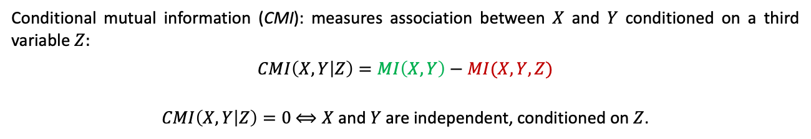
Inferring GRNs using MI and PCA
Zhang et al. (2012) first suggested inferring GRNs by employing path consistency algorithm (PCA, Spirtes et al. (2000)) based on MI.
MI estimated using Gaussian kernel.
Asymptotic behaviour used when inferring gene network is not correct.
Conditional mutual information (CMI): measures association between $X$ and $Y$ conditioned on a third variable $Z:$
$$CMI\left(X, Y | Z\right)=MI\left(X, Y\right)−MI(X, Y,Z)$$
$CMI\left(X, Y | Z\right)=0$ $⟺X$and $Y$ are independent, conditioned on $Z$.
1. Zhang, Xiujun, Xing-Ming Zhao, Kun He, Le Lu, Yongwei Cao, Jingdong Liu, Jin-Kao Hao, Zhi-Ping Liu, and Luonan Chen. “Inferring Gene Regulatory Networks from Gene Expression Data by Path Consistency Algorithm Based on Conditional Mutual Information.” Bioinformatics 28, no. 1 (January 1, 2012): 98–104.
2. Spirtes, Peter, Clark N. Glymour, and Richard Scheines. Causation, prediction, and search. MIT press, 2000.

Slide 29
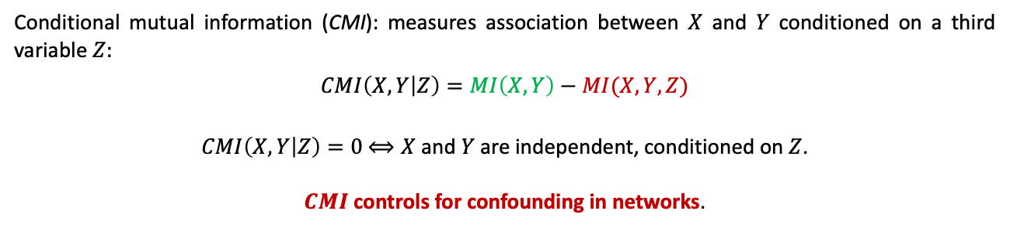
Inferring GRNs using MI and PCA
Zhang et al. (2012) first suggested inferring GRNs by employing path consistency algorithm (PCA, Spirtes et al. (2000)) based on MI.
MI estimated using Gaussian kernel.
Asymptotic behaviour used when inferring gene network is not correct.
Conditional mutual information (CMI): measures association between $X$ and $Y$ conditioned on a third variable $Z:$
$$CMI\left(X, Y | Z\right)=MI\left(X, Y\right)−MI(X, Y,Z)$$
$CMI\left(X, Y | Z\right)=0$ $⟺X$and $Y$ are independent, conditioned on $Z$.
$CMI$ controls for confounding in networks.
1. Zhang, Xiujun, Xing-Ming Zhao, Kun He, Le Lu, Yongwei Cao, Jingdong Liu, Jin-Kao Hao, Zhi-Ping Liu, and Luonan Chen. “Inferring Gene Regulatory Networks from Gene Expression Data by Path Consistency Algorithm Based on Conditional Mutual Information.” Bioinformatics 28, no. 1 (January 1, 2012): 98–104.
2. Spirtes, Peter, Clark N. Glymour, and Richard Scheines. Causation, prediction, and search. MIT press, 2000.

Slide 30
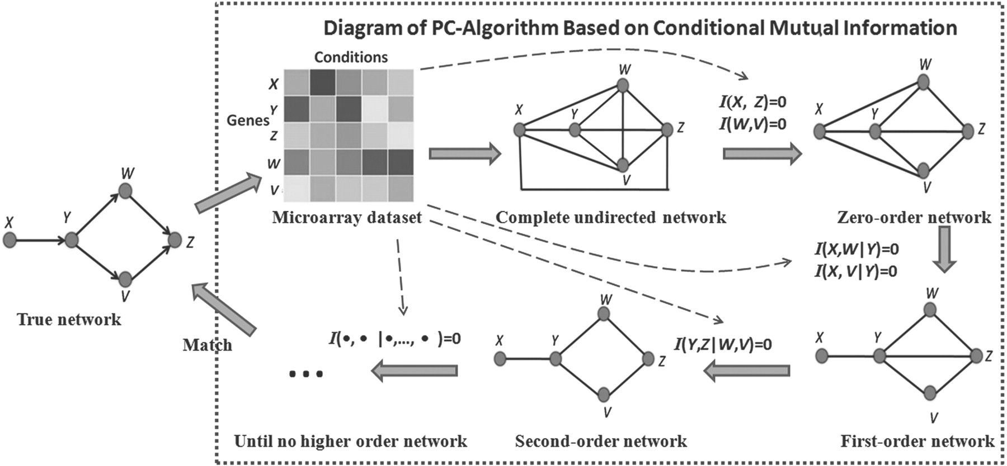
PC algorithm: GRN reconstruction
Content
mutual information
(0) Observed data
(1) Initial: complete network
(2) Pruning ‘weak’ edges
conditional mutual information
Latent network
conditional mutual information
(4) Ruling out confounding
(3) Checking confounding
Zhang, Xiujun, Xing-Ming Zhao, Kun He, Le Lu, Yongwei Cao, Jingdong Liu, Jin-Kao Hao, Zhi-Ping Liu, and Luonan Chen. “Inferring Gene Regulatory Networks from Gene Expression Data by Path Consistency Algorithm Based on Conditional Mutual Information.” Bioinformatics 28, no. 1 (January 1, 2012): 98–104.

Slide 31
PC algorithm: GRN reconstruction
Content
mutual information
(0) Observed data
(1) Initial: complete network
(2) Pruning ‘weak’ edges
conditional mutual information
Latent network
conditional mutual information
(4) Ruling out confounding
(3) Checking confounding
Zhang, Xiujun, Xing-Ming Zhao, Kun He, Le Lu, Yongwei Cao, Jingdong Liu, Jin-Kao Hao, Zhi-Ping Liu, and Luonan Chen. “Inferring Gene Regulatory Networks from Gene Expression Data by Path Consistency Algorithm Based on Conditional Mutual Information.” Bioinformatics 28, no. 1 (January 1, 2012): 98–104.

Slide 32
PC algorithm: GRN reconstruction
Content
mutual information
(0) Observed data
(1) Initial: complete network
(2) Pruning ‘weak’ edges
conditional mutual information
Latent network
conditional mutual information
(4) Ruling out confounding
(3) Checking confounding
Zhang, Xiujun, Xing-Ming Zhao, Kun He, Le Lu, Yongwei Cao, Jingdong Liu, Jin-Kao Hao, Zhi-Ping Liu, and Luonan Chen. “Inferring Gene Regulatory Networks from Gene Expression Data by Path Consistency Algorithm Based on Conditional Mutual Information.” Bioinformatics 28, no. 1 (January 1, 2012): 98–104.

Slide 33
PC algorithm: GRN reconstruction
Content
mutual information
(0) Observed data
(1) Initial: complete network
(2) Pruning ‘weak’ edges
conditional mutual information
Latent network
conditional mutual information
(4) Ruling out confounding
(3) Checking confounding
Zhang, Xiujun, Xing-Ming Zhao, Kun He, Le Lu, Yongwei Cao, Jingdong Liu, Jin-Kao Hao, Zhi-Ping Liu, and Luonan Chen. “Inferring Gene Regulatory Networks from Gene Expression Data by Path Consistency Algorithm Based on Conditional Mutual Information.” Bioinformatics 28, no. 1 (January 1, 2012): 98–104.

Slide 34
PC algorithm: GRN reconstruction
Content
mutual information
(0) Observed data
(1) Initial: complete network
(2) Pruning ‘weak’ edges
conditional mutual information
Latent network
conditional mutual information
(4) Ruling out confounding
(3) Checking confounding
Zhang, Xiujun, Xing-Ming Zhao, Kun He, Le Lu, Yongwei Cao, Jingdong Liu, Jin-Kao Hao, Zhi-Ping Liu, and Luonan Chen. “Inferring Gene Regulatory Networks from Gene Expression Data by Path Consistency Algorithm Based on Conditional Mutual Information.” Bioinformatics 28, no. 1 (January 1, 2012): 98–104.

Slide 35
PC algorithm: GRN reconstruction
Content
mutual information
(0) Observed data
(1) Initial: complete network
(2) Pruning ‘weak’ edges
conditional mutual information
Latent network
conditional mutual information
(4) Ruling out confounding
(3) Checking confounding
Zhang, Xiujun, Xing-Ming Zhao, Kun He, Le Lu, Yongwei Cao, Jingdong Liu, Jin-Kao Hao, Zhi-Ping Liu, and Luonan Chen. “Inferring Gene Regulatory Networks from Gene Expression Data by Path Consistency Algorithm Based on Conditional Mutual Information.” Bioinformatics 28, no. 1 (January 1, 2012): 98–104.

Slide 36
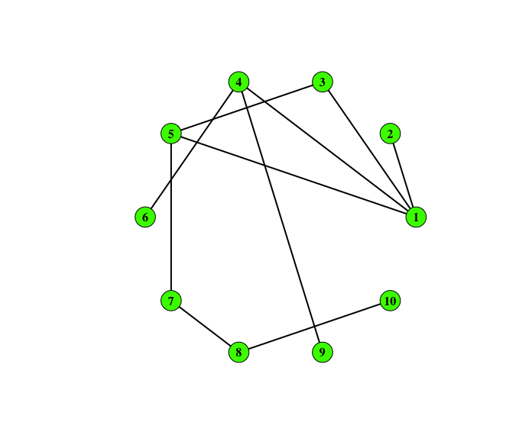
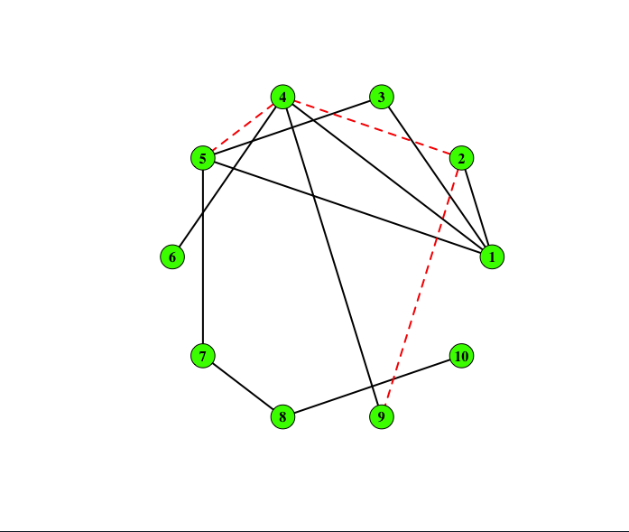
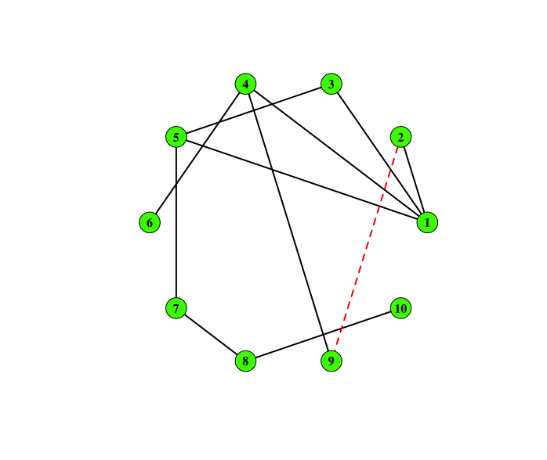
Example: GRN in DREAM3 dataset
DREAM3: benchmark gene expression data with known underlying GRN.
Aim is to predict GRN from yeast gene expression datasets.
Known GRN in DREAM3
Inferred GRN in Zhang (2012)
3 false positives
Known GRN in DREAM 3
fastMI inferred GRN
1 false positive

Slide 37
Summary
fastMI: association measures that is:
Able to detect complex association
Have attractive theoretical properties
Exhibit good practical performance (reduced error, improved runtime).
fastMI uses tuning-free estimation strategy; is a powerful test of independence.
Using fastMI, we can infer gene networks.

Slide 38
Statistics and information theory
$$X_{3}$$
$$X_{1}$$
$$X_{2}$$
$$X_{5}$$
$$X_{4}$$
In this talk: embed notions of association and directionality in information theoretic framework.
Deliverables:
Measure association in gene networks
Detect directionality between DNA methylation and blood pressure

Slide 39
Inferring Asymmetric Relations via Cross-fitting Data Analytics <epigenetic causal discovery>
Purkayastha, Soumik, and Peter XK Song. "Asymmetric predictability in causal discovery: an information theoretic approach." arXiv preprint arXiv:2210.14455 (2023).

Slide 40



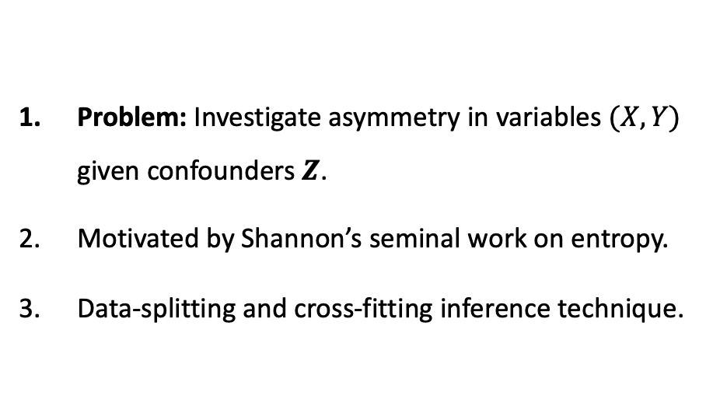
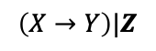

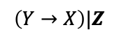


Studying asymmetry
$$Z$$
Problem: Investigate asymmetry in variables $(X, Y)$ given confounders $Z$.
Motivated by Shannon’s seminal work on entropy.
Data-splitting and cross-fitting inference technique.
$$X$$
$$Y$$
$$\left(X→Y\right)|Z$$
$$Z$$
$$X$$
$$Y$$
$$\left(Y→X\right)|Z$$

Slide 41
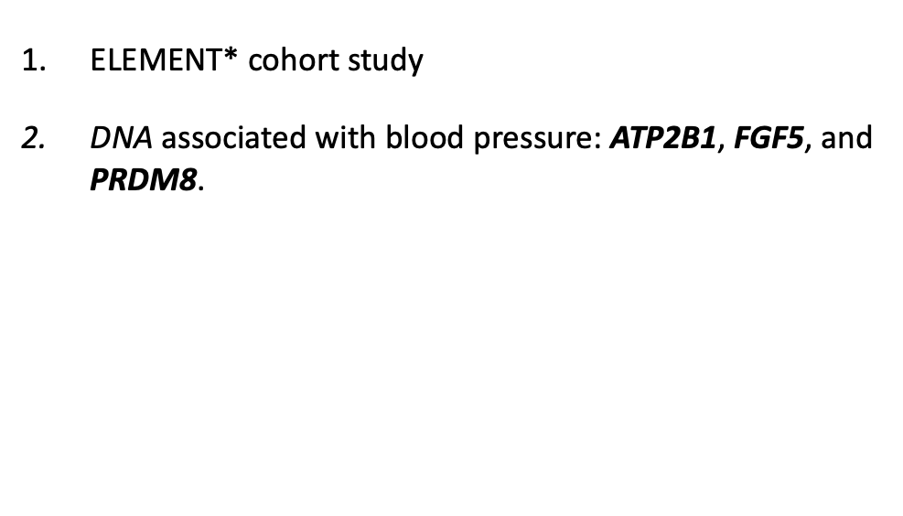
Asymmetry in DNAm and BP.
ELEMENT* cohort study
DNA associated with blood pressure: ATP2B1, FGF5, and PRDM8.
DNA expression controlled by methylation DNAm.
Epigenetics and cardiovascular function such as blood pressure (BP) are closely related (Shi et al, 2022).
Aim: confirm if (I) DNAm $→$ BP or (II) BP $→$ DNAm.
DNA
BP
*ELEMENT : Early Life Exposures in Mexico to Environmental Toxicants.

Slide 42
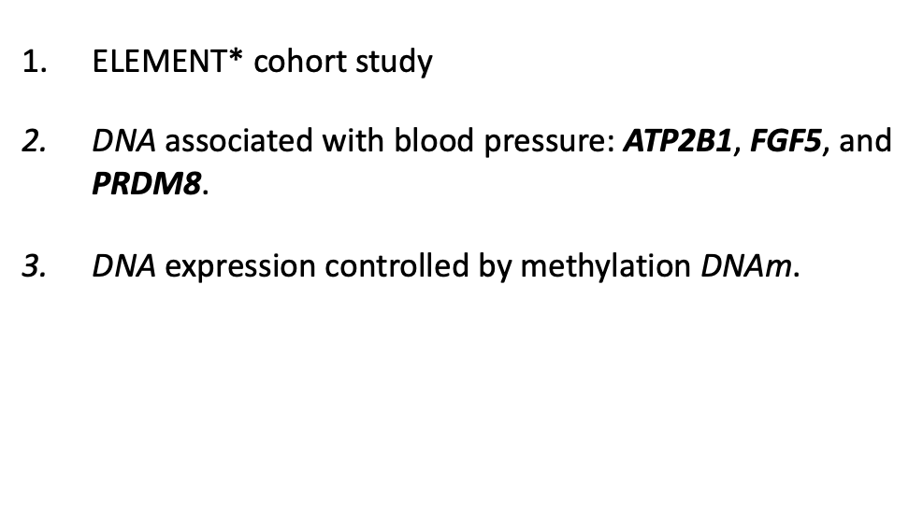
Asymmetry in DNAm and BP.
ELEMENT* cohort study
DNA associated with blood pressure: ATP2B1, FGF5, and PRDM8.
DNA expression controlled by methylation DNAm.
Epigenetics and cardiovascular function such as blood pressure (BP) are closely related (Shi et al, 2022).
Aim: confirm if (I) DNAm $→$ BP or (II) BP $→$ DNAm.
DNA
DNAm
BP
*ELEMENT : Early Life Exposures in Mexico to Environmental Toxicants.

Slide 43
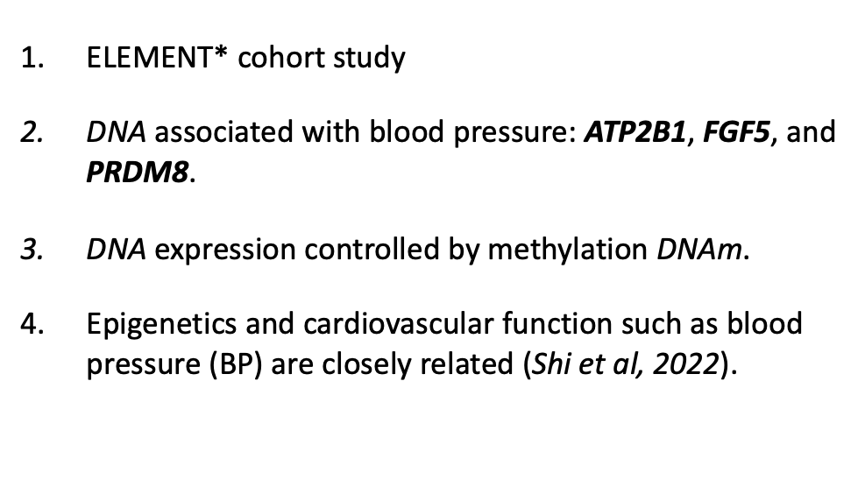
Asymmetry in DNAm and BP.
ELEMENT* cohort study
DNA associated with blood pressure: ATP2B1, FGF5, and PRDM8.
DNA expression controlled by methylation DNAm.
Epigenetics and cardiovascular function such as blood pressure (BP) are closely related (Shi et al, 2022).
Aim: confirm if (I) DNAm $→$ BP or (II) BP $→$ DNAm.
DNA
DNAm
BP
*ELEMENT : Early Life Exposures in Mexico to Environmental Toxicants.

Slide 44
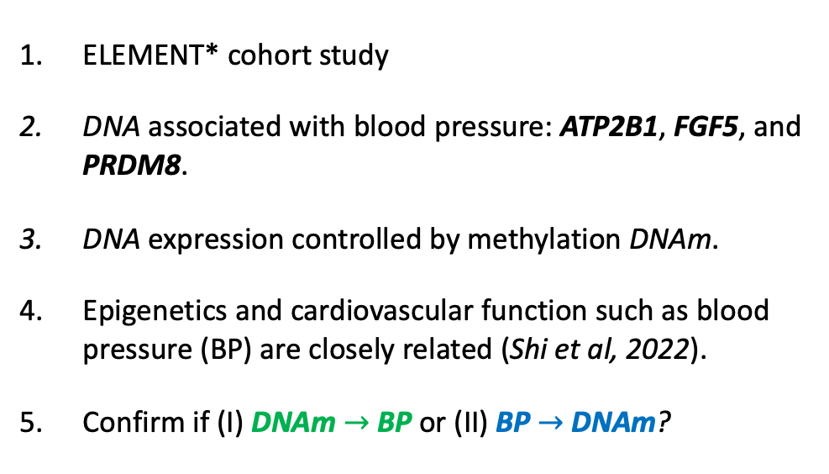
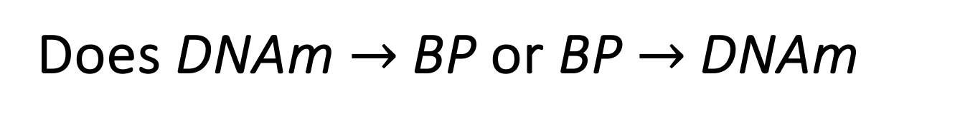
Does DNAm $→$ BP or BP $→$ DNAm
ELEMENT* cohort study
DNA associated with blood pressure: ATP2B1, FGF5, and PRDM8.
DNA expression controlled by methylation DNAm.
Epigenetics and cardiovascular function such as blood pressure (BP) are closely related (Shi et al, 2022).
Confirm if (I) DNAm $→$ BP or (II) BP $→$ DNAm?
DNAm
(I)
BP
(II)
*ELEMENT : Early Life Exposures in Mexico to Environmental Toxicants.

Slide 45
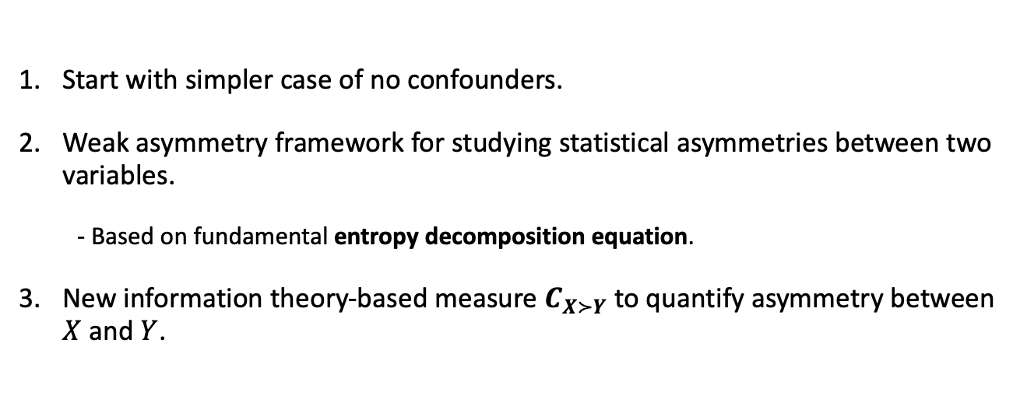

Is there asymmetry in $\left(X, Y\right)?$
Start with simpler case of no confounders.
Weak asymmetry framework for studying statistical asymmetries between two variables.
- Based on fundamental entropy decomposition equation.
New information theory-based measure $C_{X≻Y}$ to quantify asymmetry between $X$ and $Y$.

Slide 46
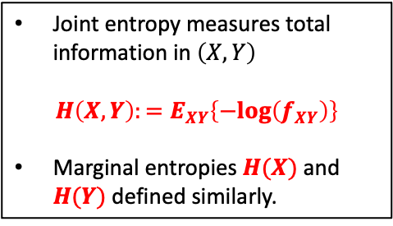
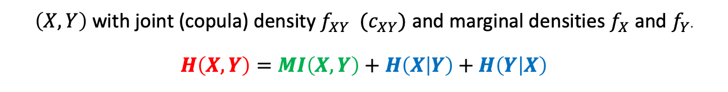
Entropy decomposition equation
$\left(X, Y\right)$with joint (copula) density $f_{XY} (c_{XY})$ and marginal densities $f_{X}$ and $f_{Y}$.
$$H\left(X, Y\right)=MI\left(X,Y\right)+H\left(X | Y\right)+H\left(Y | X\right)$$
Joint entropy measures total information in $\left(X,Y\right)$
$$H\left(X,Y\right):=E_{XY}\left\{−log\left(f_{XY}\right)\right\}$$
Marginal entropies $H(X)$ and $H(Y)$ defined similarly.

Slide 47
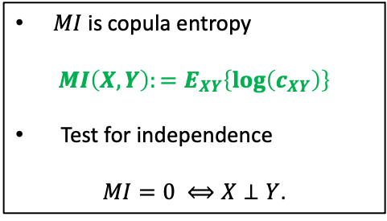
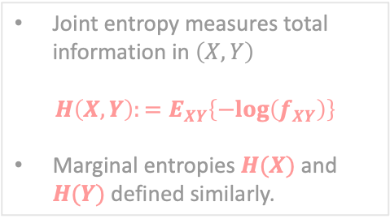
Entropy decomposition equation
$\left(X, Y\right)$with joint (copula) density $f_{XY} (c_{XY})$ and marginal densities $f_{X}$ and $f_{Y}$.
$$H\left(X, Y\right)=MI\left(X,Y\right)+H\left(X | Y\right)+H\left(Y | X\right)$$
Joint entropy measures total information in $\left(X,Y\right)$
$$H\left(X,Y\right):=E_{XY}\left\{−log\left(f_{XY}\right)\right\}$$
Marginal entropies $H(X)$ and $H(Y)$ defined similarly.
$MI$ is copula entropy
$$MI\left(X,Y\right):=E_{XY}\left\{log\left(c_{XY}\right)\right\}$$
Test for independence
$MI=0 ⟺X⊥Y$.

Slide 48
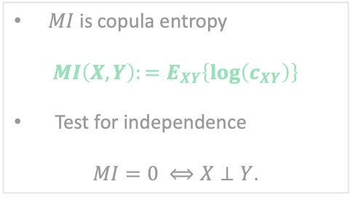
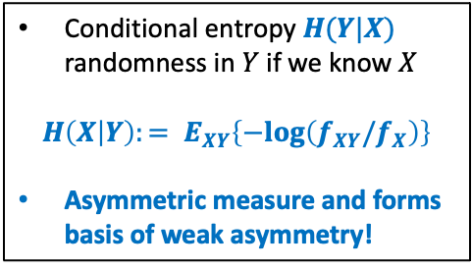
Entropy decomposition equation
$\left(X, Y\right)$with joint (copula) density $f_{XY} (c_{XY})$ and marginal densities $f_{X}$ and $f_{Y}$.
$$H\left(X, Y\right)=MI\left(X,Y\right)+H\left(X | Y\right)+H\left(Y | X\right)$$
Joint entropy measures total information in $\left(X,Y\right)$
$$H\left(X,Y\right):=E_{XY}\left\{−log\left(f_{XY}\right)\right\}$$
Marginal entropies $H(X)$ and $H(Y)$ defined similarly.
$MI$ is copula entropy
$$MI\left(X,Y\right):=E_{XY}\left\{log\left(c_{XY}\right)\right\}$$
Test for independence
$MI=0 ⟺X⊥Y$.
Conditional entropy $H(Y|X)$ randomness in $Y$ if we know $X$
$${H\left(X | Y\right):= E}_{XY}\left\{−log\left(f_{XY}/f_{X}\right)\right\}$$
Asymmetric measure and forms basis of weak asymmetry!

Slide 49
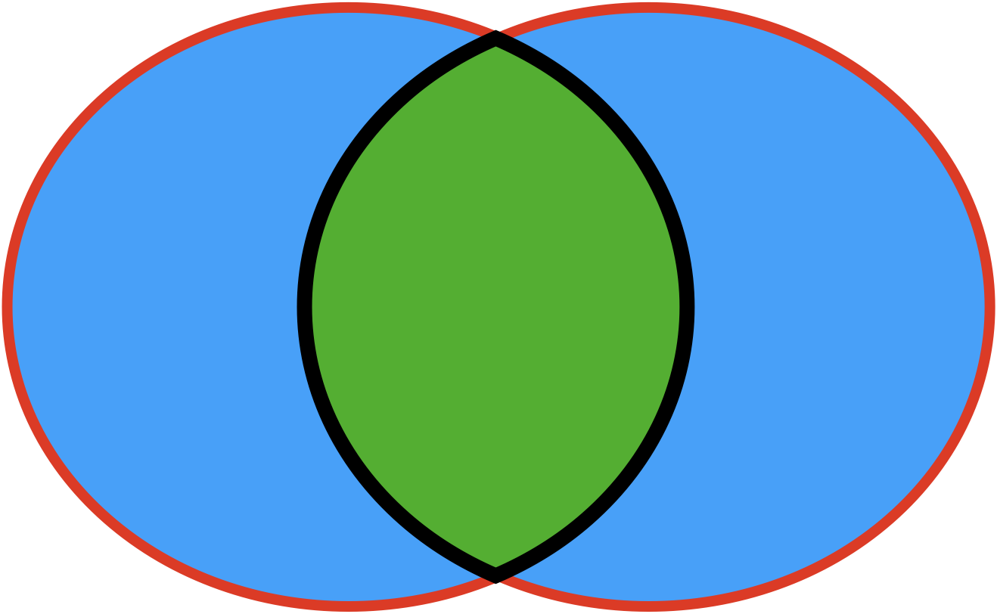
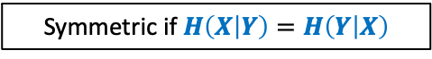
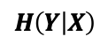
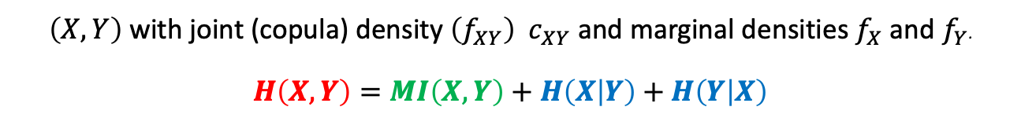
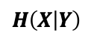
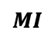
Entropy decomposition equation
$\left(X, Y\right)$with joint (copula) density $\left(f_{XY}\right) c_{XY}$ and marginal densities $f_{X}$ and $f_{Y}$.
$$H\left(X, Y\right)=MI\left(X,Y\right)+H\left(X | Y\right)+H\left(Y | X\right)$$
Symmetric if $H\left(X | Y\right)=H\left(Y | X\right)$
$$H\left(Y | X\right)$$
$$MI$$
$$H\left(X | Y\right)$$

Slide 50
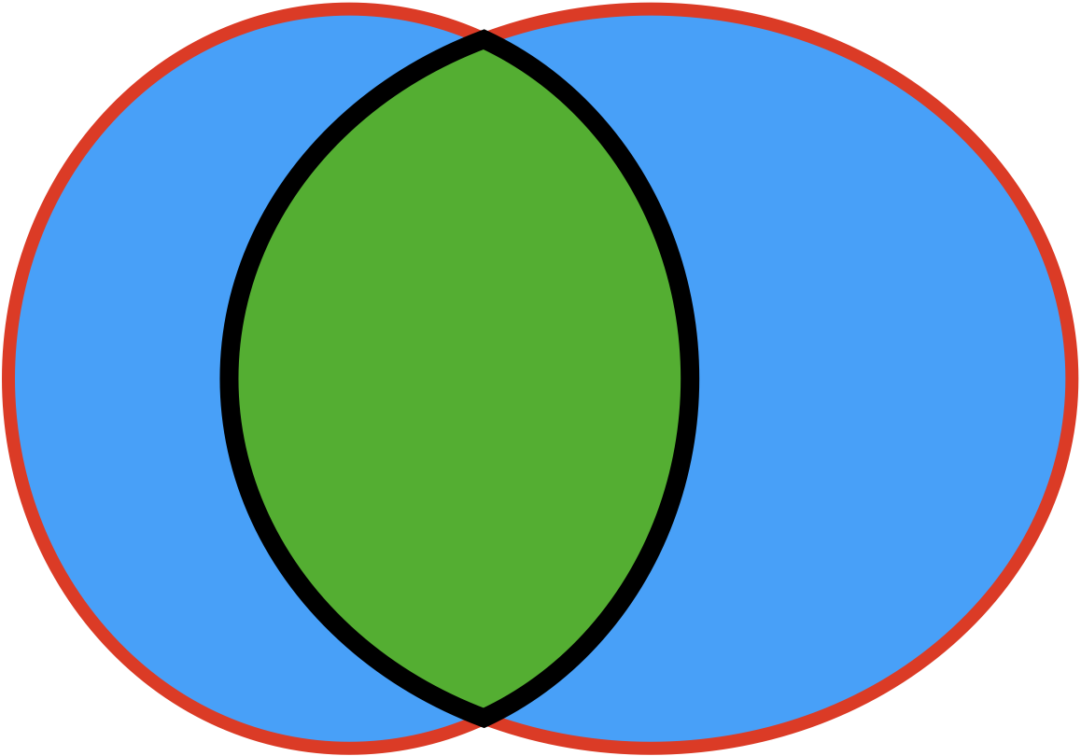
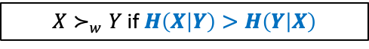
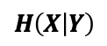
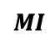
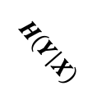
Entropy decomposition equation
$\left(X, Y\right)$with joint (copula) density $\left(f_{XY}\right) c_{XY}$ and marginal densities $f_{X}$ and $f_{Y}$.
$$H\left(X, Y\right)=MI\left(X,Y\right)+H\left(X | Y\right)+H\left(Y | X\right)$$
“Less uncertainty in $Y$ after conditioning on $Y$ than the converse”
$X≻_{w}Y$ if $H\left(X | Y\right)>H\left(Y | X\right)$
$$MI$$
$$H\left(X | Y\right)$$
$$H\left(Y | X\right)$$

Slide 51
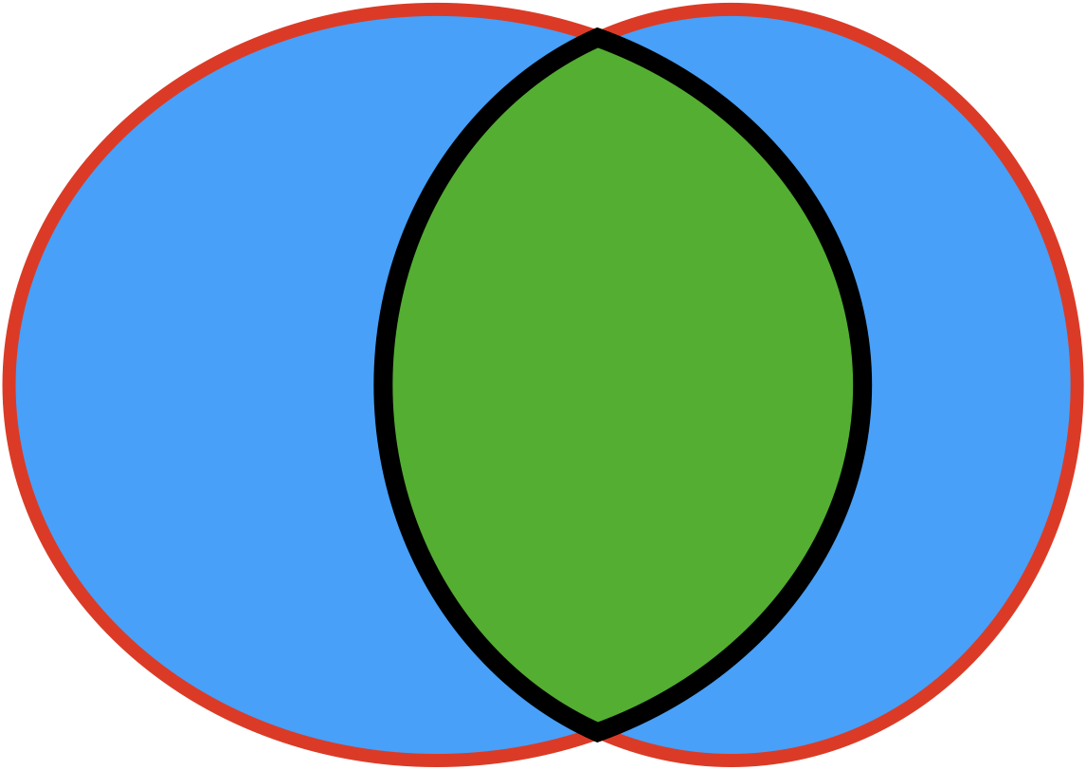



Entropy decomposition equation
$\left(X, Y\right)$with joint (copula) density $\left(f_{XY}\right) c_{XY}$ and marginal densities $f_{X}$ and $f_{Y}$.
$$H\left(X, Y\right)=MI\left(X,Y\right)+H\left(X | Y\right)+H\left(Y | X\right)$$
“Less uncertainty in $X$ after conditioning on $Y$ than the converse”
$Y≻_{w}X$ if $H\left(Y | X\right)>H\left(X | Y\right)$
$$H\left(Y | X\right)$$
$$MI$$
$$H\left(X | Y\right)$$

Slide 52


Weak asymmetry coefficient $C_{X≻Y}$
Comparison reveals potential asymmetry in predictability:
$$H\left(X | Y\right)≶H(Y|X)$$
“Asymmetric predictability is an imprint of underlying causal direction”
The weak asymmetry coefficient (WAC)
$$C_{X≻Y}=H\left(X | Y\right)−H\left(Y | X\right)=H(X)−H(Y).$$
Last equality from chain rule of entropy:
$H\left(X | Y\right)+H\left(Y\right)=H\left(X, Y\right)=H\left(Y | X\right)+H(X)$

Slide 53


Adjusting for confounders $Z$
Unadjusted weak asymmetry coefficient (WAC)
$$C_{X≻Y}=H(X)−H(Y).$$
Adjusting for confounders $Z$ by examining conditional WACs
Case 1: WAC for specific value of $Z=z_{0}$
$$C_{X≻Y|Z=z_{0}}=H(X|Z=z_{0})−H(Y|Z=z_{0}).$$
Case 2: Aggregated WAC for all possible values of $z_{0}$
$$C_{X≻Y|Z}=H(X|Z)−H(Y|Z).$$

Slide 54

Adjusting for confounders $Z$
Unadjusted weak asymmetry coefficient (WAC)
$$C_{X≻Y}=H(X)−H(Y).$$
Adjusting for confounders $Z$ by examining conditional WACs
Case 1: WAC for specific value of $Z=z_{0}$
$$C_{X≻Y|Z=z_{0}}=H(X|Z=z_{0})−H(Y|Z=z_{0}).$$
Case 2: Aggregated WAC for all possible values of $z_{0}$
$$C_{X≻Y|Z}=H(X|Z)−H(Y|Z).$$

Slide 55

Tuning-free density estimation
To estimate $C_{X≻Y}$, need consistent ${\hat{f}}_{X}, {\hat{f}}_{Y}$ of underlying $f_{X}$, $f_{Y}$.
Key idea:
Data from $f_{X}$
Instead of estimating ${\hat{f}}_{X}$ directly, consider Fourier transform${ \hat{φ}}_{X}$ of${\hat{f}}_{X}$
Obtain ${\hat{f}}_{X}$ as the Fourier anti-transform of ${ \hat{φ}}_{X}$
Under some regularity conditions (Purkayastha and Song (2023a)), ${\hat{f}}_{X}$ uniformly converges almost surely to ${\hat{f}}_{X}$.

Slide 56

Tuning-free density estimation
To estimate $C_{X≻Y}$, need consistent ${\hat{f}}_{X}, {\hat{f}}_{Y}$ of underlying $f_{X}$, $f_{Y}$.
Key steps:
Data from $f_{X}$
Instead of estimating ${\hat{f}}_{X}$ directly, consider Fourier transform${ \hat{φ}}_{X}$ of${\hat{f}}_{X}$
Obtain ${\hat{f}}_{X}$ as the Fourier anti-transform of ${ \hat{φ}}_{X}$
Under some regularity conditions (Purkayastha and Song (2023a)), ${\hat{f}}_{X}$ uniformly converges almost surely to ${\hat{f}}_{X}$.

Slide 57

Tuning-free density estimation
To estimate $C_{X≻Y}$, need consistent ${\hat{f}}_{X}, {\hat{f}}_{Y}$ of underlying $f_{X}$, $f_{Y}$.
Key steps:
Data from $f_{X}$
Instead of estimating ${\hat{f}}_{X}$ directly, consider Fourier transform${ \hat{φ}}_{X}$ of${\hat{f}}_{X}$
Obtain ${\hat{f}}_{X}$ as the Fourier anti-transform of ${ \hat{φ}}_{X}$
Under some regularity conditions (Purkayastha and Song (2023a)), ${\hat{f}}_{X}$ uniformly converges almost surely to ${\hat{f}}_{X}$.

Slide 58

Data-splitting estimation
${\hat{f}}_{X}$ and ${\hat{f}}_{Y}$: infinite-dimensional nuisance parameters; using same data for estimating density and inference for ${\hat{C}}_{X≻Y}$ may lead to bias!
Data-splitting and cross-fitting
Split data $D$ into two halves $D_{1}$ and $D_{2}.$
Use $D_{2}$ to estimate ${\hat{f}}_{X}$ and ${\hat{f}}_{Y}$ and use ${\hat{f}}_{X}$ and ${\hat{f}}_{Y}$ and $D_{1}$ to obtain ${\hat{C}}_{X≻Y}\left(1\right).$
Interchange roles of $D_{1}$ and $D_{2}$ to obtain ${\hat{C}}_{X≻Y}\left(2\right)$to obtain cross-fitted ${\hat{C}}_{X≻Y}$.

Slide 59




Data-splitting estimation
${\hat{f}}_{X}$ and ${\hat{f}}_{Y}$: infinite-dimensional nuisance parameters; using same data for estimating density and inference for ${\hat{C}}_{X≻Y}$ may lead to bias!
Data-splitting and cross-fitting
Split data $D$ into two halves $D_{1}$ and $D_{2}.$
$$D_{2}$$
Data $D$
$$D_{1}$$

Slide 60



Data-splitting estimation
${\hat{f}}_{X}$ and ${\hat{f}}_{Y}$: infinite-dimensional nuisance parameters; using same data for estimating density and inference for ${\hat{C}}_{X≻Y}$ may lead to bias!
Data-splitting and cross-fitting
Split data $D$ into two halves $D_{1}$ and $D_{2}.$
Use $D_{2}$ to estimate ${\hat{f}}_{X}$ and ${\hat{f}}_{Y}$ and use ${\hat{f}}_{X}$ and ${\hat{f}}_{Y}$ and $D_{1}$ to obtain ${\hat{C}}_{X≻Y}\left(2\right).$
${\hat{C}}_{X≻Y}(2)$ $:$=
$\hat{H_{2}}(X)$ - ${\hat{H}}_{2}(Y)$
$$D_{2}$$
Data $D$
$$D_{1}$$
${\hat{f}}_{X;1}$ and ${\hat{f}}_{Y;1}$

Slide 61





Data-splitting estimation
${\hat{f}}_{X}$ and ${\hat{f}}_{Y}$: infinite-dimensional nuisance parameters; using same data for estimating density and inference for ${\hat{C}}_{X≻Y}$ may lead to bias!
Data-splitting and cross-fitting
Split data $D$ into two halves $D_{1}$ and $D_{2}.$
Use $D_{2}$ to estimate ${\hat{f}}_{X}$ and ${\hat{f}}_{Y}$ and use ${\hat{f}}_{X}$ and ${\hat{f}}_{Y}$ and $D_{1}$ to obtain ${\hat{C}}_{X≻Y}\left(2\right).$
Interchange roles of $D_{1}$ and $D_{2}$ to obtain ${\hat{C}}_{X≻Y}\left(1\right)$.
${\hat{C}}_{X≻Y}(1)$ $:$=
$\hat{H_{1}}(X)$ - ${\hat{H}}_{1}\left(Y\right)$
${\hat{C}}_{X≻Y}(2)$ $:$=
$\hat{H_{2}}(X)$ - ${\hat{H}}_{2}(Y)$
$$D_{1}$$
$$D_{2}$$
Data $D$
${\hat{f}}_{X;2}$ and ${\hat{f}}_{Y;2}$
$$D_{2}$$
$$D_{1}$$
${\hat{f}}_{X;1}$ and ${\hat{f}}_{Y;1}$

Slide 62



Data-splitting estimation
${\hat{f}}_{X}$ and ${\hat{f}}_{Y}$: infinite-dimensional nuisance parameters; using same data for estimating density and inference for ${\hat{C}}_{X≻Y}$ may lead to bias!
Data-splitting and cross-fitting
Split data $D$ into two halves $D_{1}$ and $D_{2}.$
Use $D_{2}$ to estimate ${\hat{f}}_{X}$ and ${\hat{f}}_{Y}$ and use ${\hat{f}}_{X}$ and ${\hat{f}}_{Y}$ and $D_{1}$ to obtain ${\hat{C}}_{X≻Y}\left(2\right).$
Interchange roles of $D_{1}$ and $D_{2}$ to obtain ${\hat{C}}_{X≻Y}\left(1\right)$to arrive at cross-fitted ${\hat{C}}_{X≻Y}$.
$${\hat{C}}_{X≻Y}\text{:=}\frac{{\hat{C}}_{X≻Y}\left(1\right)+{\hat{C}}_{X≻Y}(2)}{2}$$
${\hat{C}}_{X≻Y}(1)$ $:$=
$\hat{H_{1}}(X)$ - ${\hat{H}}_{1}\left(Y\right)$
${\hat{C}}_{X≻Y}(2)$ $:$=
$\hat{H_{2}}(X)$ - ${\hat{H}}_{2}(Y)$
$$D_{1}$$
$$D_{2}$$
Data $D$
${\hat{f}}_{X;2}$ and ${\hat{f}}_{Y;2}$
$$D_{2}$$
$$D_{1}$$
${\hat{f}}_{X;1}$ and ${\hat{f}}_{Y;1}$

Slide 63

Cross-fitting inference
Setup: Given data ${\left\{\left(x_{i}, y_{i}\right)\right\}}_{i=1}^{2n}$ on $\left(X, Y\right)$, consider data splits
${D_{1}≔\left\{\left(x_{i}, y_{i}\right)\right\}}_{i=1}^{n}$ and ${D_{2}≔\left\{\left(x_{n+i}, y_{n+i}\right)\right\}}_{i=1}^{n}$
Assuming the following regularity conditions (Purkayastha and Song (2023b)) hold when estimating ${\hat{C}}_{X≻Y}\left(1\right)$ and ${\hat{C}}_{X≻Y}\left(2\right),$ we get the limiting distribution
$$\sqrt{n}\left({\hat{C}}_{X≻Y} −C_{X≻Y}\right) \underset{→}{D}N\left(0, σ_{C}^{2}\right) as n→∞,$$
where $σ_{C}^{2}≔V_{XY}\left[log\left(f_{X}(X)\right)+log\left(f_{Y}(Y)\right)\right]$ can be estimated by Monte-Carlo methods given estimated densities ${\hat{f}}_{X}$ and ${\hat{f}}_{Y}$.

Slide 64

Application II
${\hat{C}}_{X≻Y}$ based epigenetic causal discovery

Slide 65
Does DNAm $→$ BP or BP $→$ DNAm
ELEMENT* cohort study
DNA associated with blood pressure: ATP2B1, FGF5, and PRDM8.
DNA expression controlled by methylation DNAm.
Epigenetics and cardiovascular function such as blood pressure (BP) are closely related (Shi et al, 2022).
Confirm if (I) DNAm $→$ BP or (II) BP $→$ DNAm?
DNAm
(I)
BP
(II)
*ELEMENT : Early Life Exposures in Mexico to Environmental Toxicants.

Slide 66


DNAm $≻$ BP or BP $≻$ DNAm?
Three candidate genes: ATP2B1, FGF5, and PRDM8 known for significant association with BP.
Each gene has multiple methylation sites.
Using fastMI detect methylation sites within each gene that are significantly associated with BP after multiple testing correction.
Hits:
ATP2B1 has 21 sites; only 1 (ATP2B1:CG17564205) is associated with diastolic BP (DBP).
FGF5 also has 21 sites, only 1 (FGF5:CG12528713) is associated with systolic BP (SBP).
PRDM8 has 51 sites, only 1 (PRDM8:CG7462804) is associated with SBP.
Aim: For each of the hits above, investigate if $DNAm≻_{w}BP$ or $BP≻_{w}DNAm$.

Slide 67


DNAm $≻_{w}$ BP or BP $≻_{w}$ DNAm?
Three candidate genes: ATP2B1, FGF5, and PRDM8 known for significant association with BP.
Each gene has multiple methylation sites.
Using fastMI detect methylation sites within each gene that are significantly associated with BP after multiple testing correction.
Hits:
ATP2B1 has 21 sites; only 1 (ATP2B1:CG17564205) is associated with diastolic BP (DBP).
FGF5 also has 21 sites, only 1 (FGF5:CG12528713) is associated with systolic BP (SBP).
PRDM8 has 51 sites, only 1 (PRDM8:CG7462804) is associated with SBP.
Aim: For each of the hits above, investigate if $DNAm≻_{w}BP$ or $BP≻_{w}DNAm$.

Slide 68


Weak asymmetry: $DBP≻_{w}DNAm$
Findings:
Sites FGF5:CG12528713 and PRDM8:CG7462804 are significantly associated with SBP but do not exhibit asymmetry.
Site ATP2B1:CG17564205 exhibits asymmetry with DBP. We note that ${\hat{C}}_{DNAm≻DBP}$ is negative with its 95% CI not covering zero: we conclude $DBP≻_{w}DNAm$.

Slide 69

Recap
$$X_{3}$$
$$X_{3}$$
$$X_{1}$$
$$X_{2}$$
$$X_{5}$$
$$X_{1}$$
$$X_{2}$$
$$X_{5}$$
$$X_{4}$$
$$X_{4}$$
In this talk: embed notions of association and directionality in information theoretic framework.
Deliverables:
Measure association in gene networks using fastMI
Detect directionality between DNA methylation and blood pressure using $C_{X≻Y}$

Slide 70

Thank you for your time!
soumikp@umich.edu
soumikp.github.io

